Slide 1
P, NP, NPC and Approximation Algorithms
Lecture 12

Slide 2
Polynomial time vs exponential time
Polynomial O(n^{k}), where n=the input size of our problem (e.g, number of nodes in a graph, the length of strings , etc) and k is a constant (e.g., k=1, 2, 3, etc).
Exponential time: 2^{n} or n^{n}.
  n= 2, 10, 20, 30
2^{n}: 4 1024 1 million 1000 million
Suppose that
the running time of an algorithm is 2^{k}, and
our computer can solve a problem of size 100 in a hour (i. e., do 2¹⁰⁰ basic operations).
If a new computer is 1024 times faster than ours, then the new computer can solve the problem of size=100+10 (1024× 2¹⁰⁰ = 2¹⁰⁰⁺¹⁰ ) in a hour. (The improvement is very little.)
Hardware improvement has little use for solving problems that require exponential running time.
Exponential running time is considered as “not efficient”.

Slide 3
Story
All algorithms we have studied so far are polynomial time algorithms (unless specified).
Facts: people have not yet found any polynomial time algorithms for some famous problems, (e.g., Hamilton Circuit, longest simple path, Steiner trees).
Question: Do there exist polynomial time algorithms for those famous problems？
Answer: No body knows.

Slide 4
Story
Research topic: Prove that polynomial time algorithms do not exist for those famous problems, e.g., Hamilton circuit problem, 0/1 Knapsack, etc.
You can get Turing award if you can give the proof.
In order to answer the above question, people define two classes of problems, P class and NP class.
To answer if P≠NP, a rich area, NP-completeness theory is developed.

Slide 5
Class P
Decision problem: problems where the answers are either “yes” or “no”.
  Example: Euler circuit problem and Hamilton circuit problem.
  Optimization problems can be converted to decision problems.
  Shortest path: Add a length k as part of the input, using binary search on the value of k to answer the decision problem: Is there any path with length less than or equal to k.
Class P contains those decision problems that are solvable in polynomial time.
  They are problems that can be solved in O(n^{k}) time, where n is the input size and k is a constant.

Slide 6
Certifier, Certificate and Class NP
Def. Algorithm C(s, t) is a certifier for X if for every input s, the answer for s is yes iff there exist a certificate t (some information such as a solution, proof, etc) such that C(s, t)=yes.
Def: NP=set of decision problems for which there exists a poly-time certifier
C(s, t) is a poly-time algorithm.
Certificate t is of polynomial size: |t | ≤ p(|s |) for some polynomial p(⋅).

Slide 7
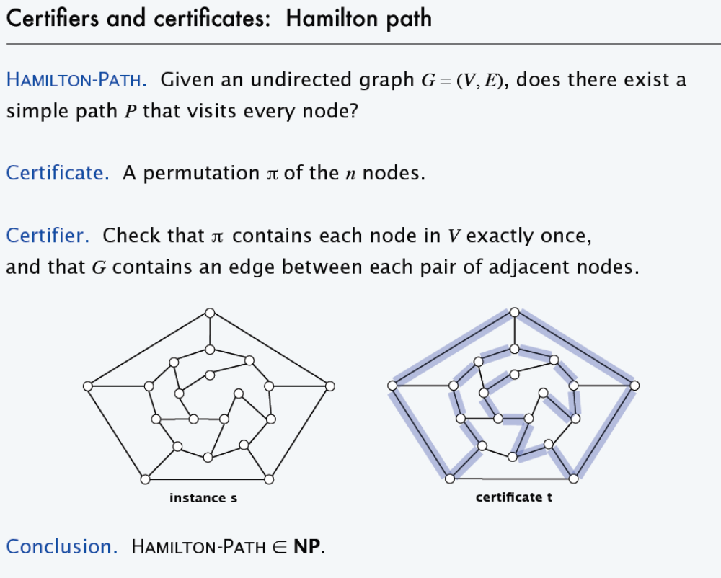

Slide 8
Boolean formula
A boolean formula f(x₁, x₂, …x_{n}), where x_{i} are boolean variables (either 0 or 1), contains boolean variables and boolean operations AND, OR and NOT .
Clause: variables and their negations are connected with OR operation, e.g., (x1 OR NOTx2 OR x5)
Conjunctive normal form of boolean formula:
contains m clauses connected with AND operation.
Example:
(x1 OR NOT x2) AND (x1 OR NOT x3 OR x6) AND (x2 OR x6) AND (NOT x3 OR x5).
  Here we have four clauses.

Slide 9
Satisfiability problem
Input: conjunctive normal form with n variables, x₁, x₂, …, x_{n}.
Problem: find an assignment of x₁, x₂, …, x_{n} (setting each x_{i} to be 0 or 1) such that the formula is true (satisfied).
Example: conjunctive normal form is
(x1 OR NOTx2) AND (NOT x1 OR x3).
The formula is true for assignment
x1=1, x2=0, x3=1.
Note: for n Boolean variables, there are 2^{n} assignments.
Testing if formula=1 can be done in polynomial time for any given assignment.
finding an assignment that satisfies formula=1 is hard.

Slide 10
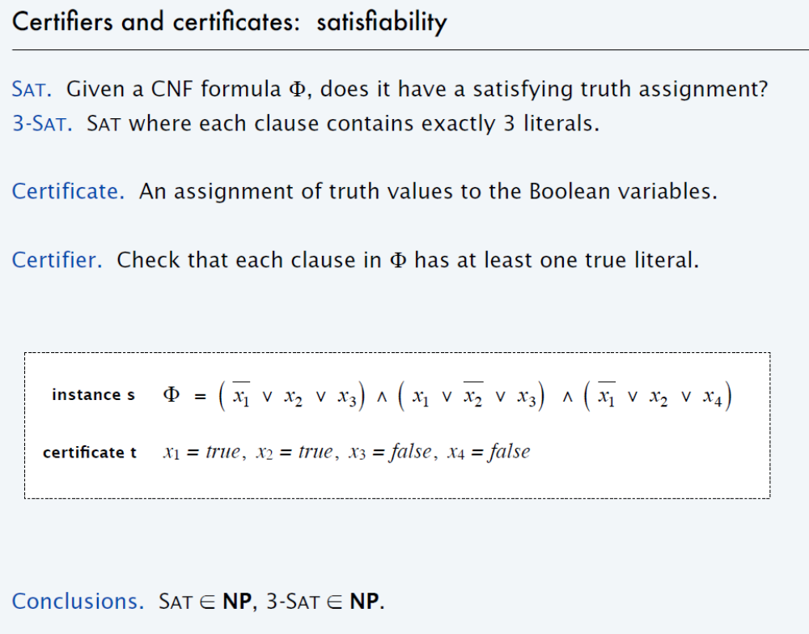

Slide 11
Class P and Class NP
  Open problem: P≠NP?
  If the answer is yes, …..
If P = NP, there would be no special value in "creative leaps," no fundamental gap between solving a problem and recognizing the solution once it's found.

Slide 12
Class P and Class NP
  Based on definitions, P⊆NP. (Proof: t=empty)
  If we can design a polynomial time algorithm for problem A, then problem A is in P.
However, if we have not been able to design a polynomial time algorithm for problem A, then there are two possibilities:
  polynomial time algorithm does not exist for problem A or
  we are not smart.
  3rd choice: To prove that the problem is NP-complete.

Slide 13
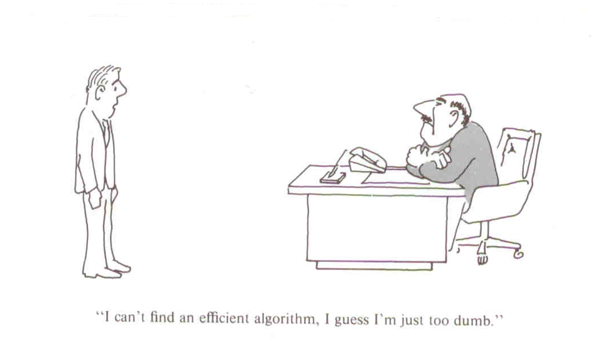
115/11/08
CS4335 Design and Analysis of Algorithms /WANG Lusheng
Page <number>

Slide 14
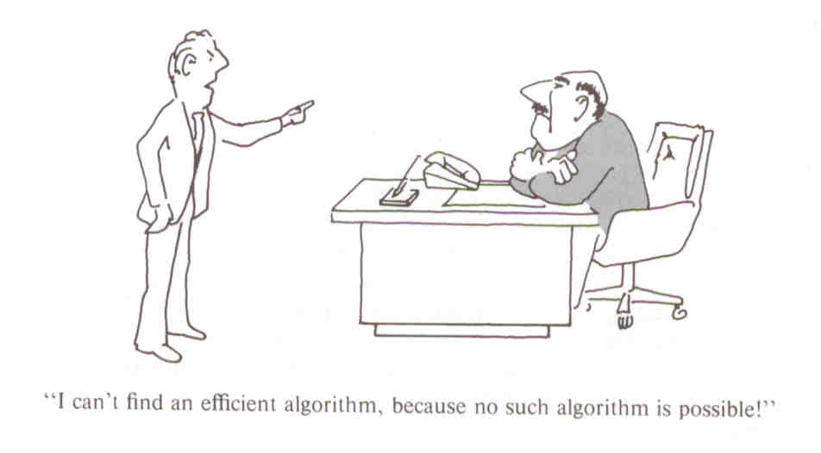
115/11/08
CS4335 Design and Analysis of Algorithms /WANG Lusheng
Page <number>

Slide 15
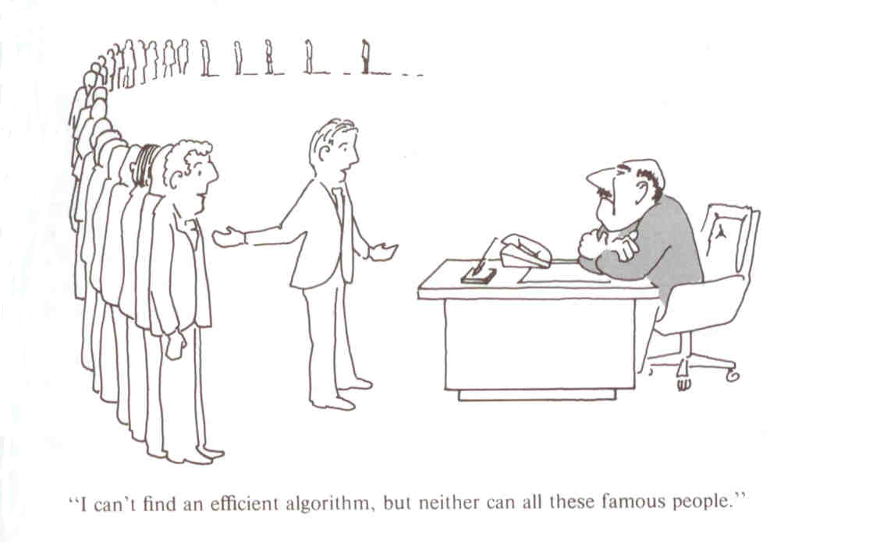
115/11/08
CS4335 Design and Analysis of Algorithms /WANG Lusheng
Page <number>

Slide 16
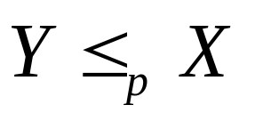
Polynomial-Time Reductions
Suppose we have a black box (an algorithm) that could solve instances of a problem X; If we give the input of an instance of X, then in a single step, the black box will return the correct answer.
Question:
Can arbitrary instances of problem Y be solved using polynomial number of standard computational steps, plus a polynomial number of calls to a black box that solves problem X?
If yes, then Y is polynomial-time reducible to X.

Slide 17
NP-Complete
can be explained as Y is not harder than X.
A problem X is NP-complete if it is in NP and any problem Y in NP has a polynomial time reduction to X.
  it is the hardest problem in NP
  If an NP-complete problem can be solved in polynomial time, then any problem in class NP can be solved in polynomial time.
The first NPC problem is Satisfiability probelm
  Proved by Cook in 1971 and obtains the Turing Award for this work

Slide 18
The First NP-complete Problem
Theorem: Satisfiability problem is NP-complete.
  It is the first NP-complete problem.
  S. A. Cook in 1971 http://en.wikipedia.org/wiki/Stephen_Cook
  Won Turing prize for his work.
Significance:
  If Satisfiability problem can be solved in polynomial time, then ALL problems in class NP can be solved in polynomial time.
  If you want to solve P≠NP, then you should work on NPC problems such as satisfiability problem.
  We can use the first NPC problem, Satisfiability problem, to show that other problems are also NP-complete.

Slide 19
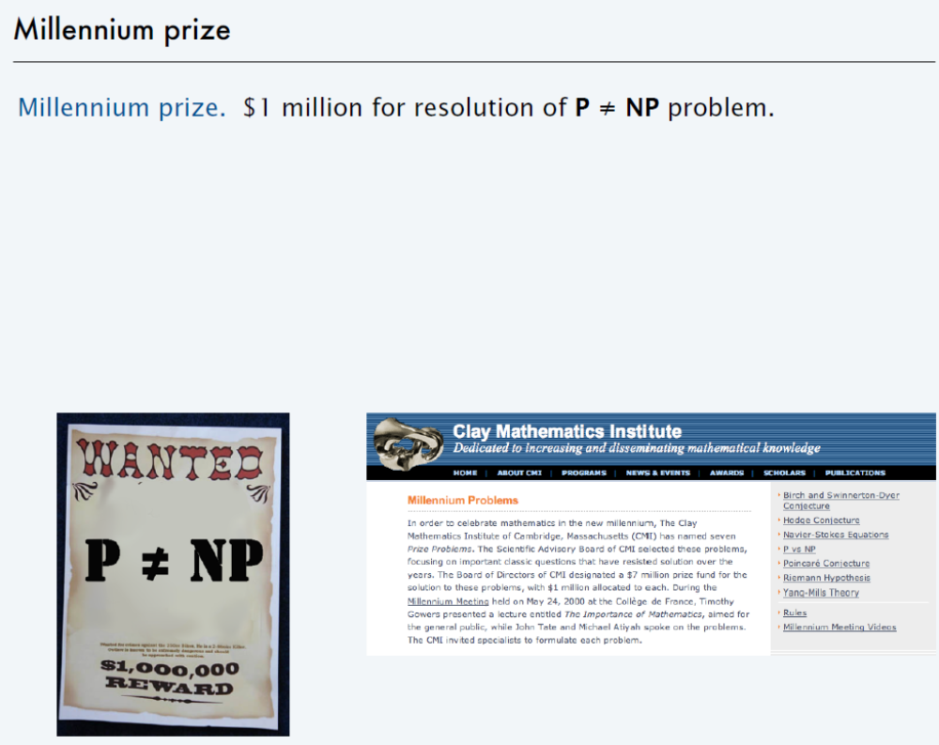

Slide 20
How to show that a problem is NPC?
To show that problem A is NP-complete, we can
  First find a problem B that has been proved to be NP-complete .
  Show that if Problem B is polynomial time reducible to A.
  Remarks: Since a NPC problem, problem B, is the hardest in class NP, problem A is also the hardest

Slide 21
Hamilton circuit and Longest Simple Path
Hamilton circuit : a circuit uses every node of the graph exactly once except for the last node= the first node.
It was shown to be NP-complete.
Longest Simple Path:
Input: V={v₁, v₂, ..., v_{n}} be a set of nodes in a graph and d(v_{i}, v_{j}) the distance between v_{i} and v_{j,}, find a longest simple path from u to v .

Slide 22
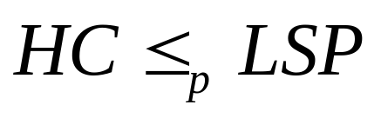
Suppose we know that Hamilton circuit (HC) is NPC, how can we prove that the longest simple path problem (LSP) is NPC.
Approach: show
  Let f(LSP) be a function to take an instance of LSP and returns a solution of input instance.
  We will design an algorithm to solve HC by calling f() polynomial number of times.

Slide 23
Theorem: The longest simple path (LSP) problem is NP-complete.
Proof:
Design a polynomial time algorithm to solve HC by using an algorithm for LSP.
Step 0: Set the length of each edge in G to be 1
Step 1: for each edge (u, v)∈E do
Step 1.1 find the longest simple path P from u to v in G.
Step 1.2 if the length of P is n-1 then by adding edge (u, v) we
obtain an Hamilton circuit in G. Print the Hamilton circuit and Stop.
Step 2: if no Hamilton circuit is found for every (u, v) then
print “no Hamilton circuit exists”
Conclusion:
if LSP can be solved in polynomial time, then HC can also be solved in polynomial.
Since HC was proved to be NP-complete, LSP is also NP-complete.

Slide 24
Some basic NP-complete problems
3-Satisfiability : Each clause contains at most three variavles or their negations.
Vertex Cover: Given a graph G=(V, E), find a subset V’ of V such that for each edge (u, v) in E, at least one of u and v is in V’ and the size of V’ is minimized.
Hamilton Circuit: (definition was given before)
History: Satisfiability→3-Satisfiability→vertex cover→Hamilton circuit.
Those proofs are very hard.
Independent set problem, max clique problem

Slide 25
Approximation Algorithms
Concepts
Steiner Minimum Tree
TSP

Slide 26
Concepts of Approximation Algorithms
Optimization Problem:
The solution of the problem is associated with a cost (value).
We want to maximize the cost or minimize the cost.
Minimum spanning tree and shortest path are optimization problems.
Euler circuit problem is NOT an optimization problem.

Slide 27
Approximation Algorithm
Approximation algorithm: give approximate solutions to optimization problems in an efficient way (=polynomial time).
How good an approximation algorithm is?
We use performance ratio to measure the quality of an approximation algorithm.

Slide 28
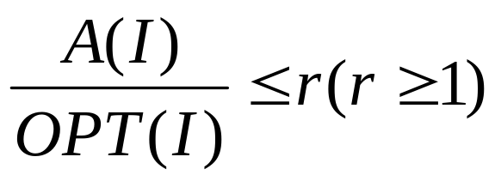
Performance ratio
For minimization problem, the performance ratio of algorithm A is defined as a number r such that for any instance I of the problem,
where OPT(I) is the value of the optimal solution for instance I and A(I) is the value of the solution returned by algorithm A on instance I.

Slide 29
Performance ratio
For maximization problem, the performance ratio of algorithm A is defined as a number r such that for any instance I of the problem,
OPT(I)
A(I)
is at most r (r≥1), where OPT(I) is the value of the optimal solution for instance I and A(I) is the value of the solution returned by algorithm A on instance I.

Slide 30
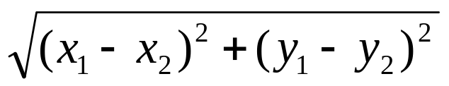
Steiner Minimum Tree
Steiner minimum tree in the plane
Input: a set of points R (regular points) in the plane.
Output: a tree with smallest total weight which contains all the nodes in R.
Weight: weight on an edge connecting two points (x₁,y₁) and (x₂,y₂) in the plane is defined as the Euclidean distance

Slide 31
Example: Dark points are regular points.

Slide 32
Triangle inequality
Key for our approximation algorithm.
For any three points in the plane, we have:
dist(a, c ) ≤ dist(a, b) + dist(b, c).
Examples:
c
5
4
a
b
3

Slide 33
Approximation algorithm
(Steiner minimum tree in the plane)
Compute a minimum spanning tree for R as the approximation solution for the Steiner minimum tree problem.
How good the algorithm is? (in terms of the quality of the solutions)
Theorem: The performance ratio of the approximation algorithm is 2.

Slide 34
Proof
We want to show that for any instance (input) I, A(I)/OPT(I) ≤ 2,
  where A(I) is the cost of the solution obtained from our spanning tree algorithm, and OPT(I) is the cost of an optimal solution.

Slide 35
Assume that T is the optimal solution for instance I. Consider a traversal of T.
10
1
9
8
5
2
3
4
6
7
Each edge in T is visited at most twice. Thus, the total weight of the traversal is at most twice of the weight of T, i.e.,
w(traversal)≤2w(T)=2OPT(I). .........(1)

Slide 36
Based on the traversal, we can get a spanning tree ST as follows: (Directly connect two nodes in R based on the visited order of the traversal.)
10
1
9
8
5
2
3
4
6
7
From triangle inequality,
w(ST)≤w(traversal) ≤2OPT(I). ..........(2)

Slide 37
Inequality(2) says that the cost of the spanning tree ST is less than or equal to twice of the cost of an optimal solution.
So, if we can compute ST, then we can get a solution with cost≤2OPT(I).
(Great! But finding ST may also be very hard, since ST is obtained from the optimal solution T, which we do not know.)
We can find a minimum spanning tree MST for R in polynomial time.
By definition of MST, w(MST) ≤w(ST) ≤2OPT(I).
Therefore, the performance ratio is 2.

Slide 38
Summary
P class: there exists polynomial time algorithms.
NP class contains those problems, where a correct solution can be verified in polynomial time.
NPC problem: the hardest in NP class. Any NP problem is polynomial time reducible to it.
Approximation Algorithm for Steiner Tree

